Slide 1
Collection FAQ

Slide 2
Content
How HashMap works internally?
What is Hashing?
What is Hash collision ?
Contract between HashCode(), equal()
Hashmap vs Hashtable
HashMap vs ConcurrentHashMap
How HashSet works internally?
can you save custom object in TreeSet? How sorting works in TreeSet?
Is ArrayList is synchronized? How we can make it synchronized?
ArrayList vs LinkedList

Slide 3
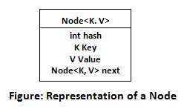
How HashMap works internally?
HashMap stores the data in the form of key-value pairs. Each key-value pair is stored in an object of Node <K, V> class.
Node<K, V> class is the static inner class of HashMap which is defined like below.
As you see, this inner class has four fields. key, value, next and hash.
key : It stores the key of an element and its final.
value : It holds the value of an element.
next : It holds the pointer to next key-value pair. This attribute makes the key value pairs stored as a linked list.
hash : It holds the hashcode of the key.
These Node objects are stored in an array called table[]. This array is initially of size 16. It is defined like below.
transient Node<K,V>[] table;

Slide 4
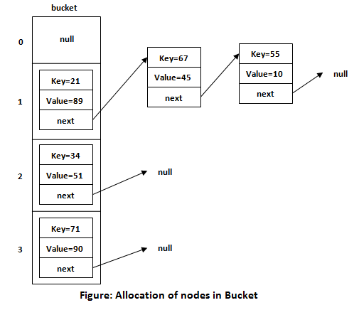

Slide 5
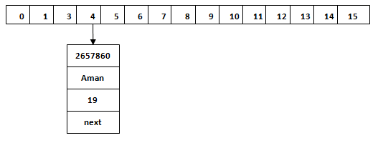

We use put() method to insert the Key and Value pair in the HashMap. The default size of HashMap is 16 (0 to 15).
HashMap<String, Integer> map = new HashMap<>();
map.put(“Aman", 19);
map.put(“John", 29);
map.put("Sunny", 18);
When we call the put() method, then it calculates the hash code of the Key "Aman." Suppose the hash code of "Aman" is 2657860. To store the Key in memory, we have to calculate the index.
Index = hashcode(Key) & (n-1) // Index = 2657860 & (16-1) = 4

Slide 6
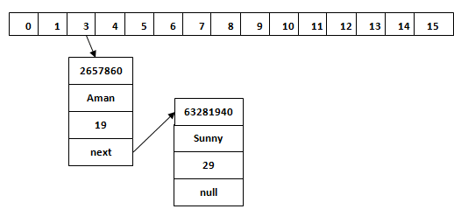
Hash Collision
when the calculated index value is the same for two or more Keys. Let's calculate the hash code for another Key "Sunny." Suppose the hash code for "Sunny" is 63281940.
Index=63281940 & (16-1) = 4
The value 4 is the computed index value where the Key will be stored in HashMap. In this case, equals() method check that both Keys are equal or not. If Keys are same, replace the value with the current value. Otherwise, connect this node object to the existing node object through the LinkedList. Hence both Keys will be stored at index 4.

Slide 7
To summarize the whole HashMap structure, each key-value pair is stored in an object of Node<K, V> class. This class has an attribute called next which holds the pointer to next key-value pair. This makes the key-value pairs stored as a linked list. All these Node <K, V> objects are stored in an array called table[].
For understanding the internal working of HashMap, you must be aware of hashCode() and equals() method.
equals(): It checks the equality of two objects. It compares the Key, whether they are equal or not. It is a method of the Object class. It can be overridden. If you override the equals() method, then it is mandatory to override the hashCode() method.
hashCode(): This is the method of the object class. It returns the memory reference of the object in integer form. The value received from the method is used as the bucket number. The bucket number is the address of the element inside the map. Hash code of null Key is 0.
Buckets: Array of the node is called buckets. Each node has a data structure like a LinkedList. More than one node can share the same bucket. It may be different in capacity.
Hashing
It doesn’t inserts the objects as you put them into HashMap i.e first element at index 0, second element at index 1 and so on. Instead it uses the hashcode of the key to decide the index for a particular key-value pair. It is called Hashing.

Slide 8
Contract between hashCode() and equal()
The default implementation of equals() in the Object class says that equality is the same as object identity. Override the equals() method so that it doesn't consider only object identity, but also the value of the two relevant properties. However, for value objects, we usually prefer equality based on their properties. Thus, we want to override equals() and hashCode().
General contract associated with hashCode() and equals() method
The hashCode() method should return the same integer value for the same object for each calling of this method unless the value stored in the object is modified.
If two objects are equal(according to equals() method) then the hashCode() method should return the same integer value for both the objects.
But, it is not necessary that the hashCode() method will return the distinct result for the objects that are not equal (according to equals() method).

Slide 9
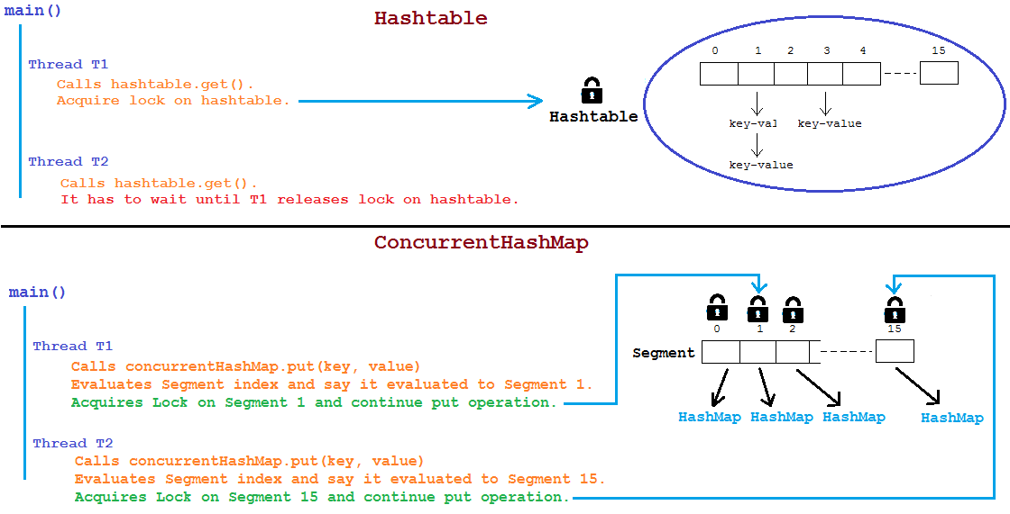
ConcurrentHashMap
It allows concurrent access to the map. Part of the map called Segment (internal data structure) is only getting locked while adding or updating the map. So ConcurrentHashMap allows concurrent threads to read the value without locking at all. This data structure was introduced to improve performance.

Slide 10
Simultaneous Read and Write operations by Multiple Threads on same or different segments of ConcurrentHashMap
Read/Get Operation :- Two Threads T1 and T2 can read data from same or different segment of ConcurrentHashMap at the same time without blocking each other.
Write/Put Operation :- Two Threads T1 and T2 can write data on different segment at the same time without blocking the other.
But Two threads can’t write data on same segments at the same time. One has to wait for other to complete the operation.
Read-Write Operation :- Two threads can read and write data on different segments at the same time without blocking each other. In general, Retrieval operations do not block, so may overlap with write (put/remove) operations. Latest updated value will be returned by get operation which is most recently updated value by write operation (including put/remove).

Slide 11
Difference between HashMap and ConcurrentHashMap
Parameters | HashMap | ConcurrentHashMap
Synchronization | Non-synchronized | synchronized
Thread-safety | Not thread-safe | Thread-safe
Iterator | It is fail-fast and throws an exception during iteration. if one thread is iterating the object and the other thread wants to modify the objects,we will get ConcurrentModificationException runtime exception | It is fail-safe and performs iteration by multiple threads. one thread can perform modification while the other thread is running. We will not get any ConcurrentModificationException.
Null Values | It allows for storing single null key and many null values. | It does not allow to store null key/values.
Introduced | The HashMap is introduced in Java 2 (JDK 1.2) | ConcurrentHashMap is introduced in Java 5 (JDK 1.5).

Slide 12
How HashSet works internally?
HashSet implements Set interface. It guarantees uniqueness. It is achieved by storing elements as keys with the same value always. When we create an object of HashSet, it internally creates an instance of HashMap with default initial capacity 16.
public class HashSet<E> extends AbstractSet<E> {
private transient HashMap<E,Object> map;
// Dummy value to associate with an Object in the backing Map
private static final Object PRESENT = new Object();
public HashSet() {
map = new HashMap<>();
}
public boolean add(E e) {
return map.put(e, PRESENT)==null;
} }
When call to add(object) is delegated to put(key, value) internally. Where key is the object we have passed and the value is another object, called PRESENT. It is a constant in java.util.HashSet.

Slide 13
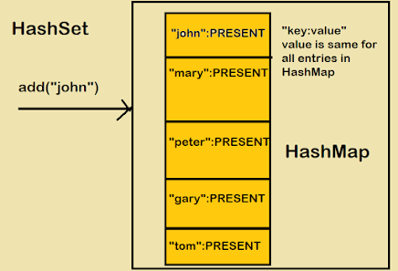
When we add an element in HashSet like hs.add(“John"), Java does internally is that it will put that element E here " John" as a key into the HashMap (generated during HashSet object creation). It will also put some dummy value that is Object's object is passed as a value to the key.
The important points about put(key, value) method is that:
If the Key is unique and added to the map, then it will return null
If the Key is duplicate, then it will return the old value of the key.
When we invoke add() method in HashSet, Java internally checks the return value of map.put(key, value) method with the null value.
If the method map.put(key, value) returns null, then the method map.put(e, PRESENT)==null will return true internally, and the element added to the HashSet.
If the method map.put(key, value) returns the old value of the key, then the method map.put(e, PRESENT)==null will return false internally, and the element will not add to the HashSet.

Slide 14
Can you save custom object in TreeSet? How sorting works in TreeSet?
TreeSet is an implementation of the SortedSet interface in java that uses a red-black tree for storage. By default, It maintains an ascending order. It contains unique elements only. It doesn’t allow null elements. Access and retrieval times are quite fast. To add the user-defined object into TreeSet, we need to implement a Comparable interface and override the compareTo() method so that it will sort our set in a particular order. An element that we want to add in TreeSet must be a comparable type. If we don’t implement the Comparable interface then it will throw ClassCastException.

Slide 15
If we are not satisfying with default natural sorting order (or) if default natural sorting order is not available then we can define our own customized sorting by Comparator object.
Comparable meant for default natural sorting order.
Comparator meant for customized sorting order.
public int compare(Object obj1,Object Obj2);

Slide 16
Difference between Comparable and Comparator
Comparable | Comparator
Comparable provides a single sorting sequence. In other words, we can sort the collection on the basis of a single element such as id, name, and price. | The Comparator provides multiple sorting sequences. In other words, we can sort the collection on the basis of multiple elements such as id, name, and price etc.
Comparable provides compareTo() method to sort elements. | Comparator provides compare() method to sort elements.
Comparable is present in java.lang package. | A Comparator is present in the java.util package.
We can sort the list elements of Comparable type by Collections.sort(List) method. | We can sort the list elements of Comparator type by Collections.sort(List, Comparator) method.

Slide 17
Is ArrayList is synchronized? How we can make it synchronized?
Implementation of ArrayList is not synchronized by default. We can use Collections.synchronizedList(List<T>) method to synchronize collections in java. The synchronizedList(List<T>) method is used to return a synchronized (thread-safe) list backed by the specified list.
Public static List synchronizedList(list l);
public static Set synchronizedSet(Set s);
public static Map synchronizedMap(Map m);

Slide 18
Thank You

